Slide 1
Evolve Full Stack Developer
Intro to Computer Science

Slide 2
So uh.. Where’s the science in your computer science?

Slide 3
Introduction to computer science
Background
What’s being studied
Travelling Salesman - an “unsolveable” problem
What can be done?
Data Structures
Reference vs Value
Types of Lists
Trees, and Graphs
Indexes
Algorithms
Sorting examples
Complexity Theory - Big O
Other Common Complexity
List has duplicate check… two approaches and the complexity

Slide 4
What is computer science?
Computer science is the study of computation, automation, and information.
Computer science spans theoretical disciplines, such as algorithms, theory of computation, and information theory, to practical disciplines including the design and implementation of hardware and software.
Computer science is generally considered an area of academic research and distinct from computer programming.
"What are the fundamental capabilities and limitations of computers?" - Theory of computation
Our program is designed to train you as a software developer, and we’re teaching you how to program.
Computer science is more academic but it still has some useful things to tell us about what is possible as a software developer.

Slide 5
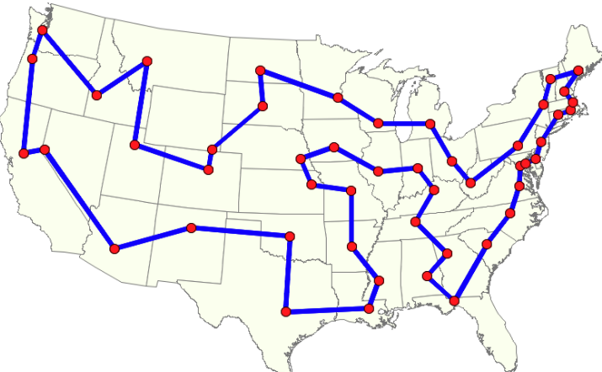
Travelling Salesman Problem
An approachable “unsolveable” problem as a motivation.
There is a group of cities or stores you need to visit.
What’s the shortest possible path to go to each store and then come back

Slide 6
Seems solvable but…
That example looks solved, why is that hard?
Let’s start with just raw power. There are 48 cities, so pick one then there are 47 cities you could go to next, then 46 third cities.
So there are 48*47*46*...*1 or 48! possible paths. (12,413,915,592,536,072,670,862,289,047,373,375,038,521,486,354,677,760,000,000,000)
Naively just crunching paths is just too huge even on a computer that could theoretically do millions of checks every second the number is still beyond any calculation we can feasibly do.
So we look at that huge problem space and immediately start thinking of ways we could make it better.
No solution would go from LA to New York then back to Las Vegas. Etc.
All those changes you want to make are the things that make up Computer Science.
We’re teaching you to how write software but computer science can help us write software that might solve our most difficult problems.

Slide 7
What can we do with Computer Science
Work on new solutions
Study other fields for possible solutions:
Discrete Mathematics
Formal Logic
Linear Algebra
Information theory
Introduce new ideas to computer science:
Data Structures
Algorithms
Improve computers:
Moore’s Law
Quantum Computing (https://www.youtube.com/watch?v=lvTqbM5Dq4Q)
Describe how bad it is
Complexity Theory
Heuristics. When all else fails we can change the problem
Algorithms that generate a solution that isn’t necessarily the “best” or “shortest” but is good enough.
Why spend decades calculating the perfect route when you could calculate a good route and then do the route in less than a month?

Slide 8
Data Structures: Value vs Reference
Value
let x = 0;
let y = x;
y = 2;
console.log(x);
Reference
let x = {val: 0};
let y = x;
y.val = 2;
console.log(x);
In this example Y is pointing to the same thing as X. They are both references to an object.

Slide 9
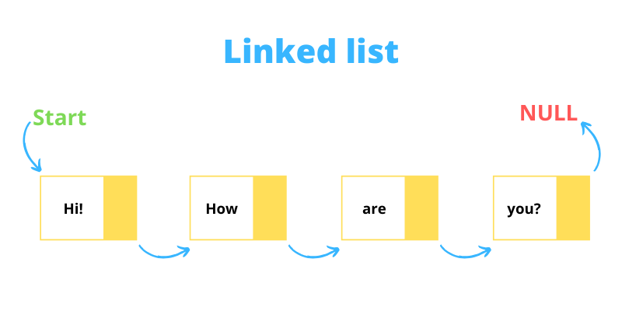
Data Structures: Linked List
We can use references to make
Interesting data structures
let list = {val: "you?", next: null};
list = {val: "are", next: list};
list = {val: "How", next: list};
list = {val: “Hi!”, next: list};
console.log(list.next.next.val); // are

Slide 10
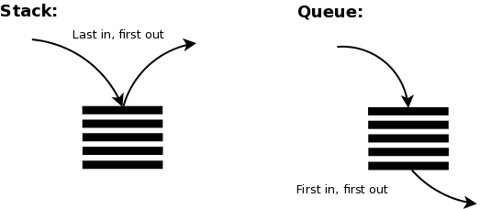
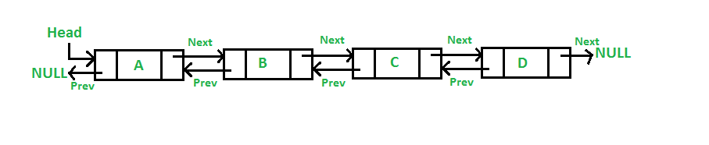
Data Structures: List Variants
Stack and Queue
Queue: Enqueue and Dequeue.
First In, First Out
Stack: Push and Pop
Last In, First Out
Doubly Linked List
Keep track of next and previous

Slide 11
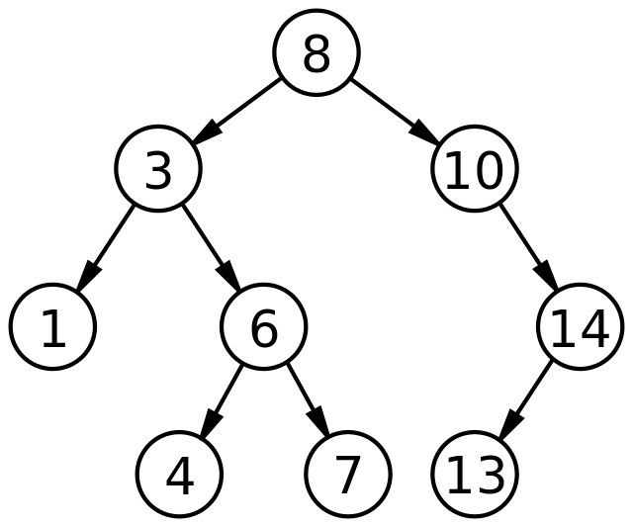
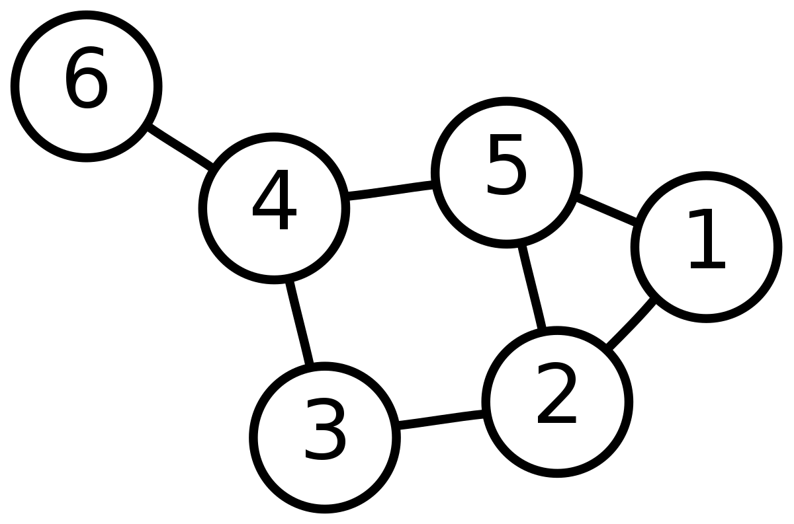
Data Structures: Trees and Graphs
Binary Search Tree
Question for later thought:
How many nodes could be in this tree?
What’s the minimum depth for 31 nodes?
Graph

Slide 12
Data Structure: Index and Maps
Map/ Dictionary/ Index
A set of keys associated with data that might be elsewhere.
Maps are very closely related to the JS objects you already know:
let x = {}
x.lecturer = {name: “Chris”}
There are similar concepts for databases called indexes that find data in various databases
All are designed to find data quickly
Can often contain small parts of the data so that you can filter on the key and not the data

Slide 13
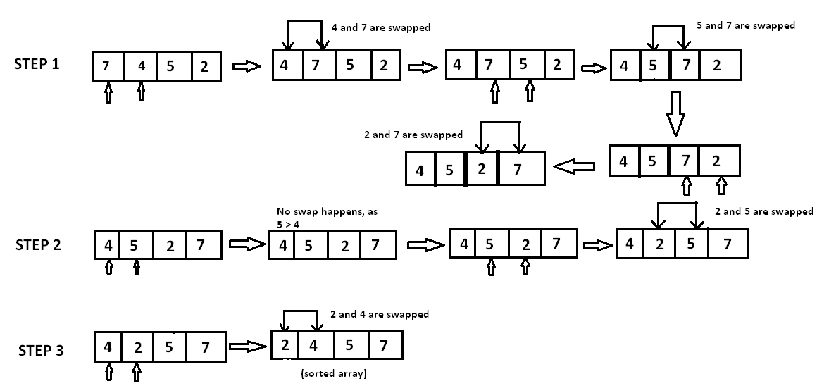
Algorithms: Bubble Sorting
Start at one end and swap anything not sorted
Repeat until you go through the list without making any swaps

Slide 14
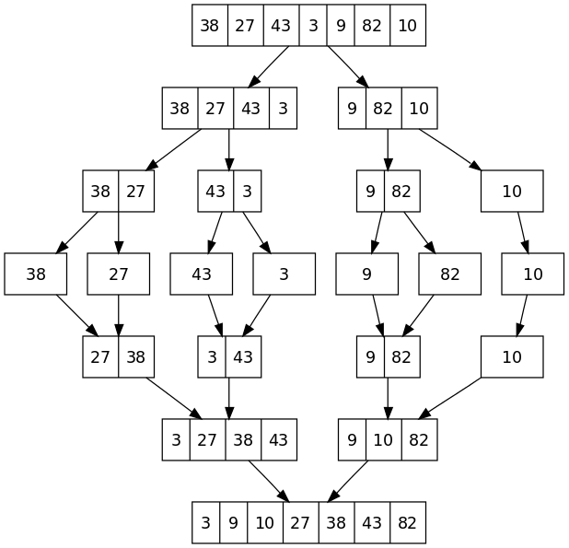
Algorithms: Merge Sorting
Split the list in half until you have pieces that are just one length, If its only 1 length then it’s sorted
Merge the pieces back together in pairs, keeping the results sorted

Slide 15
Complexity Theory
We know there are problems that are problems we can’t solve and we know there are simple problems.
Complexity theory is about finding metrics that can be used to compare solutions based on how much resources the algorithm uses
Generally we look at two resources:
Number of iterations which roughly tells time
Memory used which tells us how big the data structure used to solve the problem
All those references can add up!
There are other things we might judge but rarely:
Number of processors or computers used
Cost if some calculations may be more expensive
Communication

Slide 16
Complexity Theory: Big O
Background
There are lots of ways we might judge algorithm complexity but the most common measurement is worst-case performance
You could measure best-case performance or average performance but then maybe your program only works sometimes? There are other measures for those though
Big O notation is a simplification of a calculable complexity.
If you determined that the number of steps in an algorithm is at worst
N² -3N +17 it’s big O notation would be O(N²)
Big O notation is useful because it gives a good simple explanation of how much resources an algorithm is going to use at worst as the size of the problem (N) grows

Slide 17
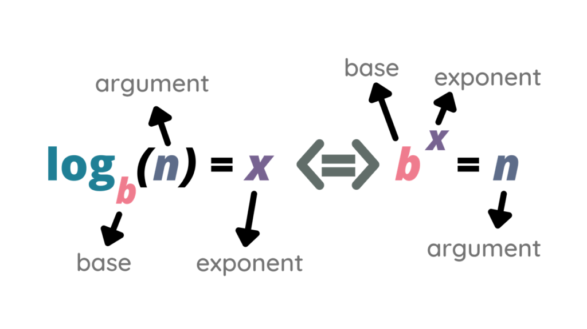
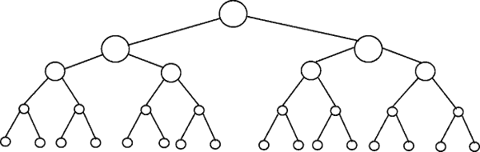
What’s with log anyway?
There are 16+8+4+2+1 (31) elements in this tree.
Log(31) = 4.95 and the tree has a depth of 5
If we added one more node then we’d have to go depth six. The tree has a minimum depth of Log(#nodes)+1
When you see Log it means you are reducing the amount of work in half (or maybe a third or a tenth) each step.

Slide 18
Common Big O Complexities
Big O | Commonly Called | N = 1000 | Example Algorithm
O(1) | constant | 1 | A calculation, a server call, an array lookup (dictionary/index lookups come close too), stack or queue operations
O(log(n)) | Log or logarithmic | 10 (9.9) | Look up in BST
O(N) | linear | 1000 | A linear calculation on every element of an array, finding an element in a linked list
O(N *log(N)) | N Log N | 9,966 | Creating a binary search tree, merge sort
O(N²) | Squared | 1 million | Bubble sort is O(N²)
O(2^{N}) | Geometric | 10³¹ | Generating every number of N bits.
O(N!) | Factorial | 3x10³⁵⁶⁵⁹ | Brute force Travelling Salesman
10⁸² atoms in the universe!

Slide 19
Comparing Two Algorithms for complexity
function findDupes(){
for(let i = 0; i < arr.length; i++)
for(let j = 0; j < arr.length; j++)
if(arr[i] === arr[j] && i != j) {
console.log(‘dupe value’, arr[i]);
return arr[i];
}
}
function findDupesTwo(){
const arrSorted = arr.sort();
for(let i = 0; i < arrSorted.length-1; i++)
if (arrSorted[i] === arrSorted[i+1]) {
console.log(‘dupe value’, arrSorted[i]);
return arrSorted[i];
}
}

